Slide 1

International Data Spaces
Ids communication guide v2
Julia Pampus
Dortmund, december 7TH, 2022

Slide 2
motivation
Experience has shown that interoperability is crucial
but hard to achieve without a normative specification.

Slide 3





Task force
interested
IDSA members
iterative process
international
standard
weekly
meeting
GitHub
repository
Notes:
https://github.com/International-Data-Spaces-Association/ids-specification

Slide 4
Scope
Programming language and implementation technology neutral
Forward & backward compati-bility
Verifiable software conformance (test frame-work)
Out-of-scope
Governance, certification, or trust aspects
Cross-data space communication
Auditing and clearing house
Custom semantic models and vocabularies

Slide 5
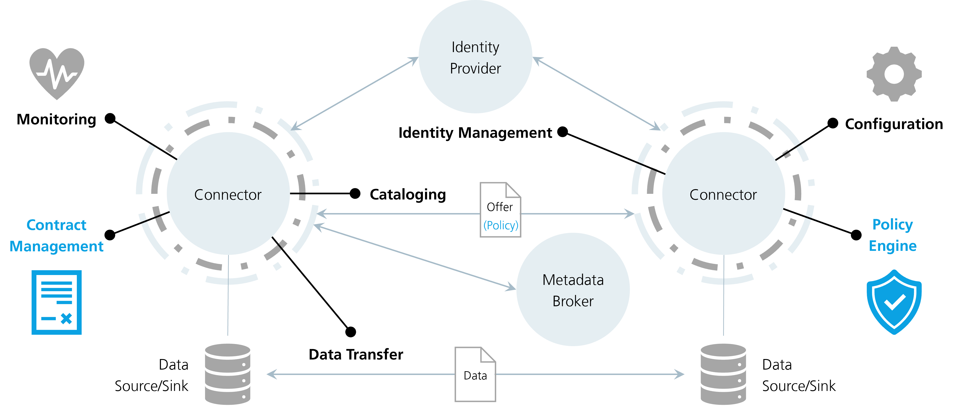
Focus
Cataloging
Contract Negotiation
Data Transfer

Slide 6
Vision
API Binding
The binding of messages and protocols to transports.
IDS Protocols
The state machines for message flows between participants.
Catalog
Negotiation
Transfer
IDS Messages
The exchanged information and their schemas.
Catalog
Negotiation
Transfer
DCAT
ODRL
IDS Information Model
The main concepts in a dataspace and their interrelationships.

Slide 7
Adoption
IDS
Data Space X
API Binding
Domain-specific API Binding
IDS Protocols
Custom Protocol
Catalog
Negotiation
Transfer
e.g. added signature processes
based on
IDS Messages
Custom Messages
Catalog
Negotiation
Transfer
Custom Namespace
DCAT
ODRL
e.g. agreed-upon policies
IDS Information Model
Custom governance

Slide 8
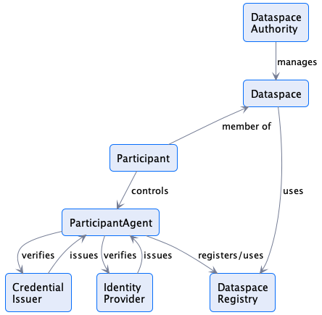
Information model

Slide 9
Ids protocols
Catalog protocol

Slide 10
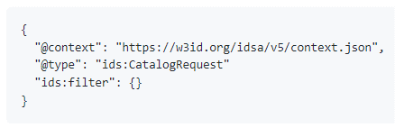
Catalog protocol
Overview
Request: CatalogRequestMessage (sent by consumer)
Response: DCAT Catalog (sent by provider, cataloging service)
Queries and Filter Expressions
May support queries or filter expressions as an implementation-specific feature
Client-side querying: periodically crawling, caching, querying against local storage
Replication Protocol
Design for federated services without the need for a replication protocol
Each consumer is responsible for issuing requests to 1..N catalog services
Security
It is expected (not required) that catalog services implement access control
Allowing different security mechanisms (part of the catalog binding specification)
Catalog Broker
Trusted access to 1..N upstream catalog services and advertises their catalogs
Expected to honor upstream access control requirements

Slide 11
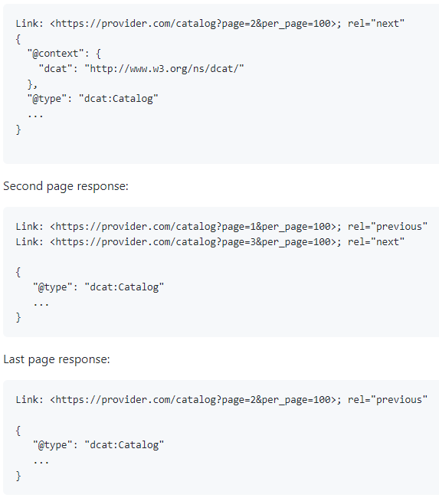
Catalog protocol
HTTPS binding
Mandatory Path Bindings (provided by actor P = provider or C = consumer)
POST https://BASE_URL/catalog/request (P)
Authorization
HTTP Authorization header with a token
Content of the token is undefined (e.g., OAUTH2, Web DID, or other)
Pagination
Using Web Linking and the HTTP Link header
Link header will contain URLs for navigating to previous and subsequent results
Asynchronous Interactions
Optional support for asynchronous callbacks for the catalog response
Require adding a callbackAddress property and an @id to the request

Slide 12
Catalog protocol
Vocabulary – Dcat Mapping
Asset Entry
Is a DCAT Dataset
May have 1..N dcat:hasPolicy (ODRL offer)
Offers must NOT contain any target
The target of an offer is the asset associated with the containing asset entry
Distribution
An asset may contain 1..N DCAT Distributions
Must have at least one DataService
DataService
May specify an IDS service endpoint (e.g., Connector)
Specifies the endpoint for initiating a negotiation/data transfer
DCAT Version 3: https://www.w3.org/TR/vocab-dcat-3

Slide 13
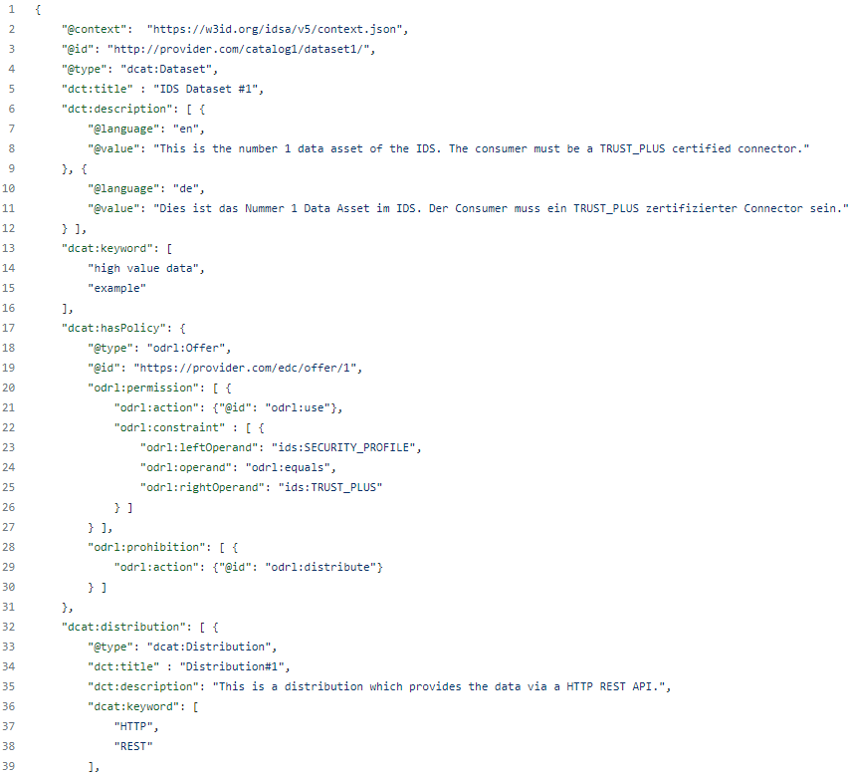
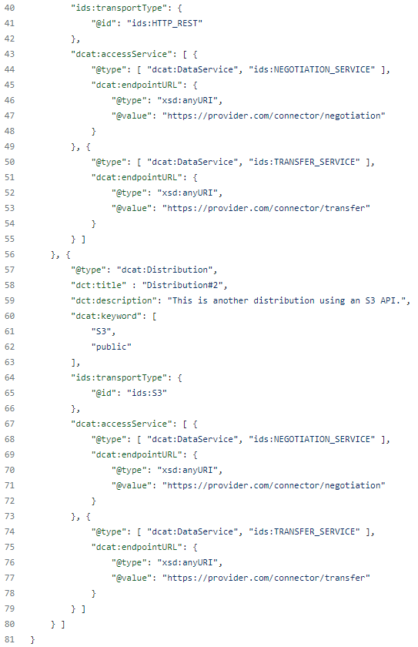
Catalog protocol
Catalog Example

Slide 14
Ids protocols
Negotiation protocol

Slide 15
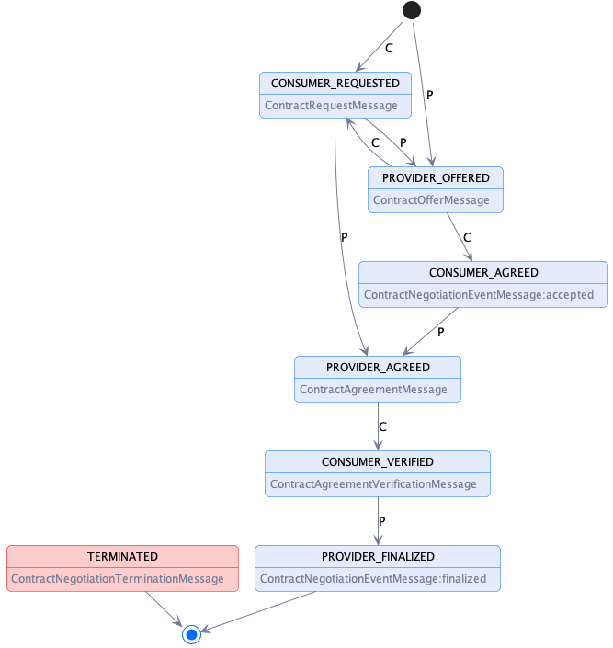
negotiation protocol
State machine

Slide 16
negotiation protocol
Ids messages
Messages
ContractRequestMessage → CONSUMER_REQUESTED, TERMINATED
ContractAgreementMessage → PROVIDER_AGREED, TERMINATED
ContractAgreementVerificationMessage → CONSUMER_VERIFIED, TERMINATED
ContractNegotiationEventMessage → PROVIDER_FINALIZED, CONSUMER_AGREED, TERMINATED
ContractNegotiationTerminationMessage → TERMINATED
ContractNegotiationErrorMessage → TERMINATED
TODO: Signature process (define checksum calculations etc.)

Slide 17
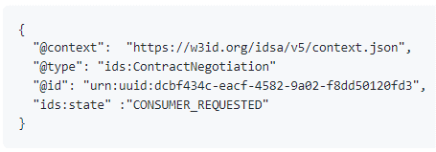
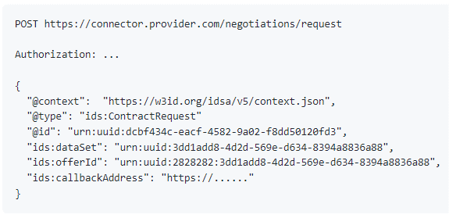
Negotiation protocol
HTTPS Binding
Mandatory Path Bindings (provided by actor P = provider or C = consumer)
GET https://BASE_URL/negotiations/:id (P)
POST https://BASE_URL/negotiations/request (P)
POST https://BASE_URL/negotiations/:id/request (P)
POST https://BASE_URL/negotiations/:id/events (P/C)
POST https://BASE_URL/negotiations/:id/agreement/verification (P)
POST https://BASE_URL/negotiations/:id/termination (P)
POST https://BASE_URL/negotiations/:id/offers (C)
POST https://BASE_URL/negotiations/:id/agreement (C)
Format: Request & response messages must use the application/json media type
Authorization (optional)
Include data as specified by an authorization protocol (e.g., OAuth2)
No mandate for use of a particular authorization standard

Slide 18
Ids protocols
Transfer protocol

Slide 19
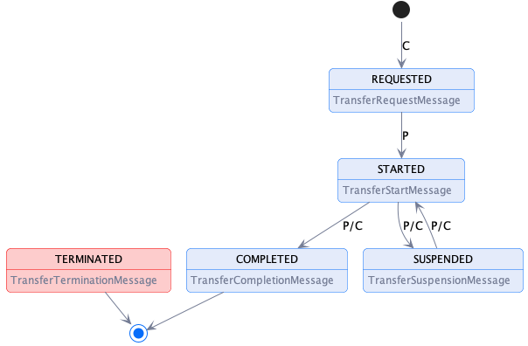
Transfer protocol
State machine

Slide 20
Transfer protocol
Ids messages
Data Transfer Types
Push vs. Pull (always initiated by consumer)
Finite vs. non-finite data
Messages
TransferRequestMessage → REQUESTED
TransferStartMessage → STARTED
TransferSuspensionMessage → SUSPENDED
TransferCompletionMessage → COMPLETED
TransferTerminationMessage → TERMINATED
TransferErrorMessage → TERMINATED

Slide 21
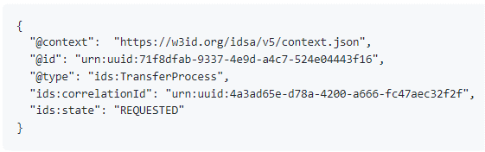
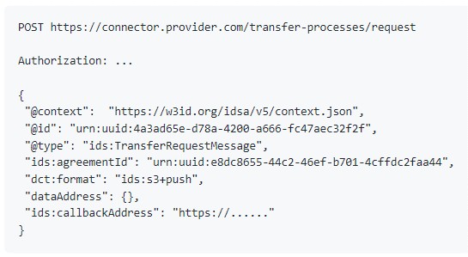
Transfer protocol
HTTPS Binding
Mandatory Path Bindings (provided by actor P = provider or C = consumer)
GET https://BASE_URL/transfer-processes/:id (P)
POST https://BASE_URL/transfer-processes/request (P)
POST https://BASE_URL/transfer-processes/:id/start (P/C)
POST https://BASE_URL/transfer-processes/:id/completion (P/C)
POST https://BASE_URL/transfer-processes/:id/termination (P/C)
POST https://BASE_URL/transfer-processes/:id/suspension (P/C)
Format: Request & response messages must use the application/json media type
Authorization (optional)
Include data as specified by an authorization protocol (e.g., OAuth2)
No mandate for use of a particular authorization standard

Slide 22
Thank you.
Any Questions or feedback?

Slide 23


!
Julia Pampus
RESEARCher
Data BUSINESS
Julia.pampus@isst.fraunhofer.de
+49 231 97677 429
Fraunhofer ISST
Emil-Figge-Str. 91
44227 Dortmund | Germany
Join us
@ids_association
# internationaldataspaces

